Slide 1
Welcome to the webinar Improve Shaker Vibration Testing With Inductive Centring Systems (ICS)
All attendees‘ microphones are muted for the entire webinar session. Be sure your speaker is active and join the audio conference. If you have any questions, please send it to the host using the “Q&A” function. Questions will be answered at the end of the presentation.

Slide 2
Introductions – Brian Zielinski-Smith
Bachelor of Sciences with Honours in Engineering Design
Design Engineer at Welding Alloys Ltd, UK
Operations Manager at Welding Alloys Ltd, UK
Product Manager at Welding Alloys Global
Joined Brüel & Kjær in 2016 (based in Royston, UK)
Product Manager – Shakers & Amplifiers
Product Manager – Shaker Systems

Slide 3
Agenda
Current Electrodynamic Centring Technology A brief look at the current centring technology used within the LDS range of Vibration Test Systems
Centring Technology Innovation What is Inductive Centring Technology, how does it work and why utilise it within an Electrodynamic Shaker System
Why Implement Decision process behind implementing a newly established centring system
Summary An overview of the Inductive Centring System on Electrodynamic Shaker Systems

Slide 4
1. Current Electrodynamic Centring Technology A brief look at the current centring technology used within the LDS range of Vibration Test Systems

Slide 5
Current Electrodynamic Centring Technology
Centring Positioning System (CPS)
Infra-red (IR) Sensor - Top plate mounted
Reflective target - Armature mounted
Based on optical reflection
Analogue conversion
Continuous position calculation
LED armature position indication
Notes:
Sensing and dynamic adjustment of the armature position is achieved by means of a centre positioning system (CPS).
No oscillation about the mid-position = offset signal applied to the armature drive signal; this function is enabled whenever the amplifier modules are
enabled.
If the armature exceeds the rated stroke the amplifier initiates system shut-down; further overtravel protection is included on slip table systems.

Slide 6
Current Electrodynamic Centring Technology
01
02
03
04
IR beam projected at reflective target
Signal converted to analogue output (0 – 5 V dc)
Amplifier continuously calculates armature position from output
Current armature position displayed on LED rosette
Notes:
As the position of the armature varies, the target reflects more or less of the beam from the sensor.
Feedback from sensor - Analogue conversion = 0-5 V dc (conversion by IR amplifier on shaker body)
Output passed to the amplifier which continuously calculates the current position of the armature.
The current armature position is displayed by an LED rosette on the pneumatics box.

Slide 7
Current Electrodynamic Centring Technology
It’s worked for years, so why innovate?
Self-adhesive foil printed matt white with a black target divided into different areas
Susceptible to environmental conditions
Can lead to armature drifting
Incorrect positional information displayed
False interlock activities
Need to replace reflective targets
Regular maintenance
Notes:
Less than 0.5 V
0.8 V
2 to 3.4 V (approx. 2.7 V at mid-position)
4.6 V
Greater than 4.75 V
The overtravel PCB is fitted internally to the IR amplifier. It provides an overtravel signal when the CPS output is outside a fixed range of 0.5 to 4.75V, i.e. outside regions 2 to 4 on the target.
Regular maintenance needed – downtime on system! Not conducive of high productivity!

Slide 8
2. Centring Technology Innovation What is Inductive Centring technology? How does it work? Why utilise it within an Electrodynamic Shaker System?

Slide 9
Centring Technology Innovation
3 part position control for easy armature and shaker assembly
ICS Sensor PCB
ICS Control PCB
ICS Target

Slide 10
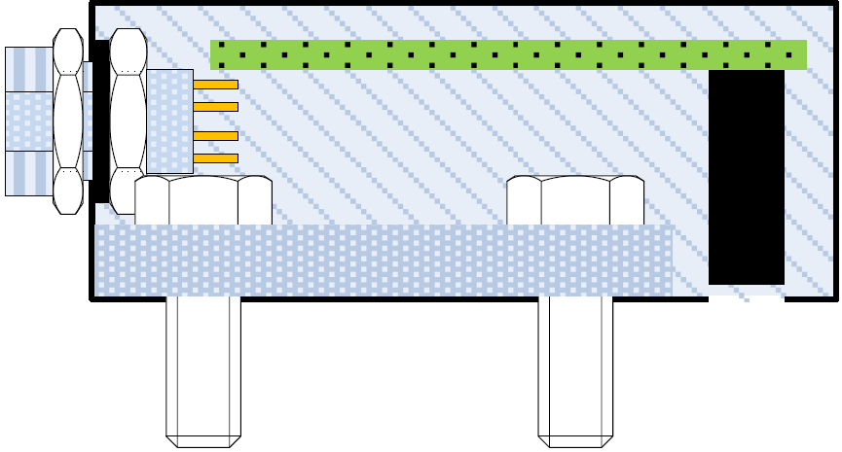
Centring Technology Innovation
Inductive Positioning System (ICS)
ICS Control PCB
Mounted in the sensor head above the Sensor PCB
Converts induced analogue signals to a digital position output
Fed back to amplifier
ICS Sensor PCB
Sense PCB consists of two sets of position sense coils, “coarse” and “fine” mounted on vibrator top plate
Allows precise measurements to be made
Length of PCB determines shaker displacement
ICS Target PCB
Sensor target is a resonant circuit mounted to armature
Multi-turn PCB and two capacitors
Set to make the target resonant in the region of 4MHz
ICS Control PCB
ICS Target PCB
ICS Sensor PCB
Notes:
3-part assembly for armature position control
Sensor spaced 5-10 mm from target
Sensor output will always be given in steps of 0.1mm.
The centre, over-travel and end-stop positions are stored on the sensor head so they cannot be changed by accident.
The profile may be required to operate outside safe limits, or to operate off-centre, but the sensor does not need to be aware of this.
To allow this condition, the sensor will output position data, and the ICS will be responsible for indicating over-travel conditions and reporting them to the system via interlocks.

Slide 11
Centring Technology Innovation
What we found during development:
Found components not shielded against magnetic field
Original bracket encouraged conduction of magnetic field
Adhesive mounting of target unable to cope with frequency range
What we changed:
Changed components to enable operation within the magnetic field of the shaker
New bracket & material to deflect stray magnetic field
Mechanically fix ICS Target PCB to armature

Slide 12
3. Why Implement? Decision process behind implementing a newly established centring system

Slide 13
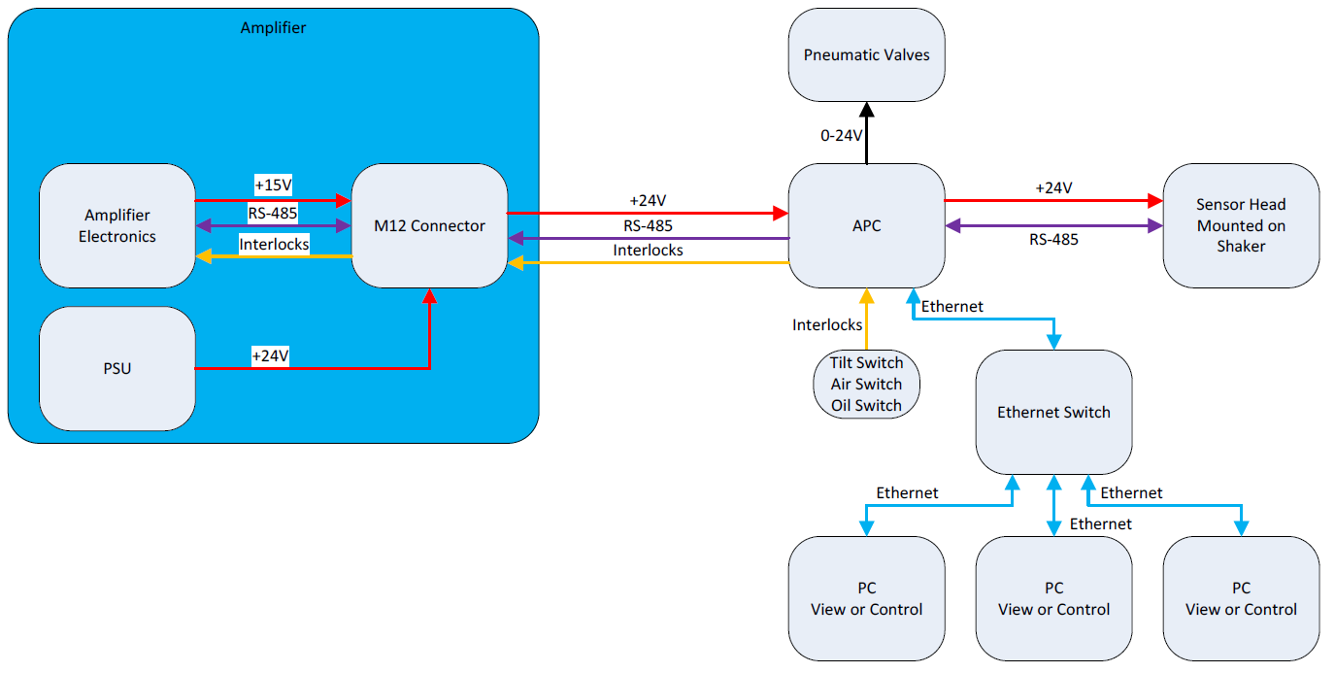
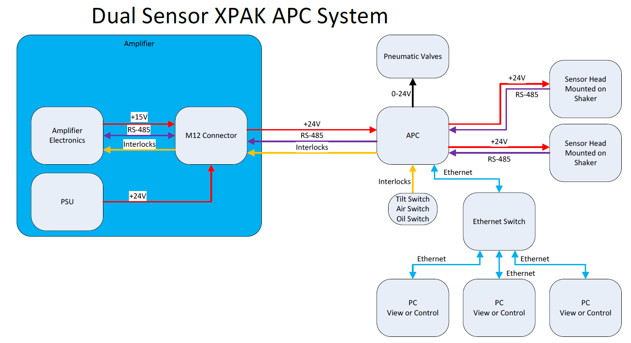
Why Implement?
Why move to inductive sensors?
Non-Contact = No wearing parts
Non-Optical = Not affected by environmental conditions
Well proven technology in the automotive industry
No system downtime caused by armature position loss
No re-calibration (absolute position)
Unaffected by magnetic fields
Dual shaker position control
Notes:
No wear = no spares needed
Automotive industry = Crankshaft sensors, Camshaft sensors, Anti-Locking Brakes etc.
Calibrated twice (production & commission)

Slide 14
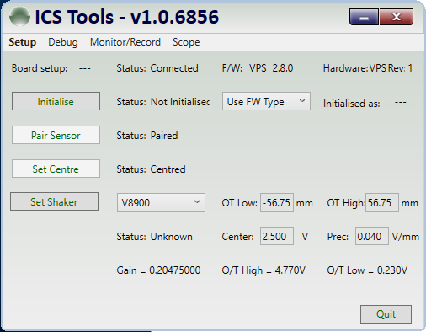
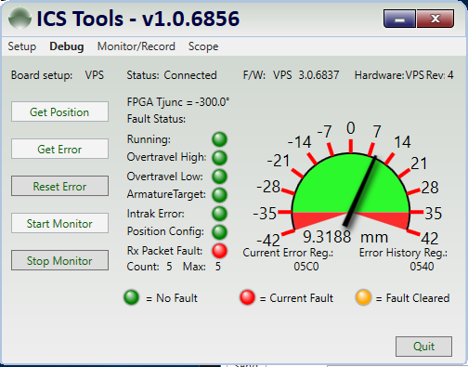
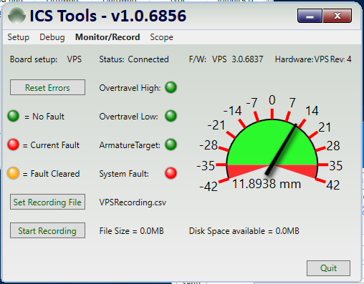
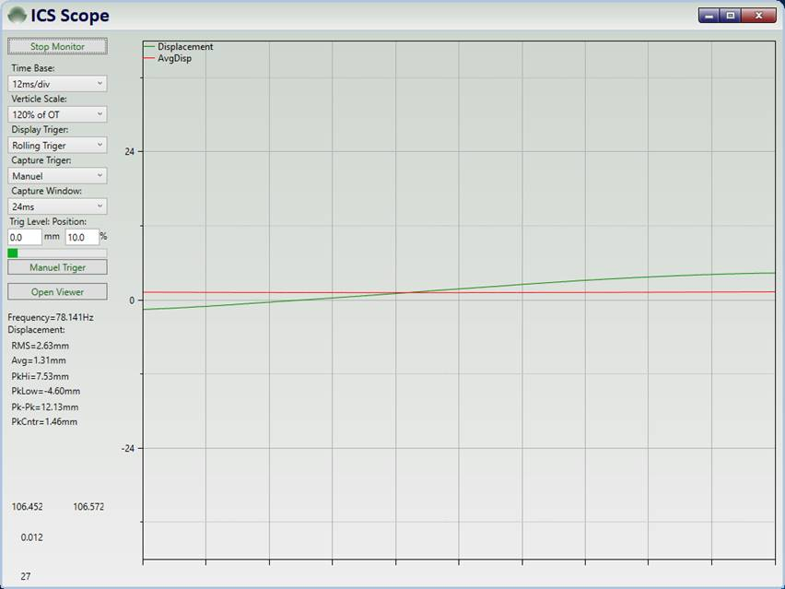
Why Implement?
Why move to inductive sensors?
Improved diagnostics for fault finding
Easy set up (installation & post armature replacement)
Monitor ICS performance and displacement accuracy
Record displacement & armature position data
Realtime view of positional data

Slide 15
4. Summary An overview of the Inductive Centring System on Electrodynamic Shaker Systems

Slide 16
Summary
An overview of the Inductive Centring System (ICS)
No wearing parts = No spares requirement
Unaffected by environmental conditions
No ongoing maintenance requirement
Absolute positioning
High accuracy @ 0.1mm increments
Improved/real-time shaker diagnostics & fault finding
Simplifies dual shaker positional feedback

Slide 17
Questions?

Slide 18
Brian Zielinski-Smith – Product Manager Shaker Systems brian.zielsinski-smith@hbkworld.com +44 (0) 1223 389 822 https://www.bksv.com/en/Campaign/HQ/ICS-launch/ICS

